Slide 1
Electronics Components
Applied Physics
Labs-01
BSCS-II

Slide 2
The active and passive components are differentiated on various factors like the nature of the source, its functions, power gain, controlling the flow of current.
Electronics Components
Active Components
Passive Components
Active components deliver power or energy to the circuit.
Passive elements utilizes power or energy from the circuit.
They do not require any external source for the operations.
They require an external source for the operations.

Slide 3
omparison Chart
BASIS | ACTIVE COMPONENTS | PASSIVE COMPONENT
Nature of source | Active components deliver power or energy to the circuit. | Passive elements utilizes power or energy from the circuit.
Examples | Diodes, Transistors, Integrated circuits etc. | Resistor, Capacitor, Inductor etc.
Function of the component | Devices which produce energy in the form of voltage or current. | Devices which stores energy in the form of voltage or current.
Power Gain | They are capable of providing power gain. | They are incapable of providing power gain.
Flow of current | Active components can control the flow of current. | Passive components cannot control the flow of the current.
Requirement of external source | They require an external source for the operations. | They do not require any external source for the operations.
Nature of energy | Active components are energy donor. | Passive components are energy acceptor.

Slide 4
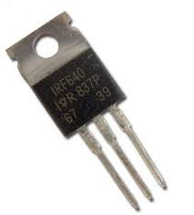
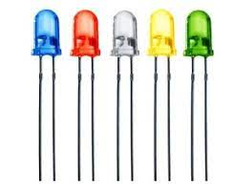
Active Components
It has Ability / capacity to provide power (source) to the circuit .
It also control (limit) current flowing in circuit
Power gain / Amplification.
Example –
Voltage Source , Current source , Generator (AC , DC ) All type of transistor, Zener diode , Photodiode , LED and etc.

Slide 5
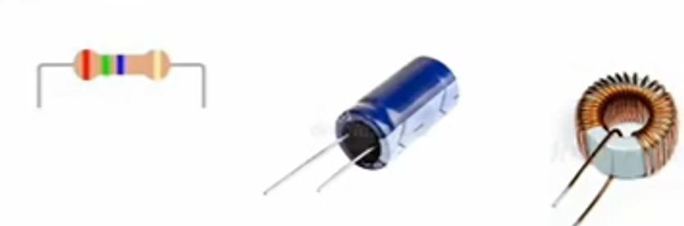
Passive Components
It has Ability to Dissolve/absorb or store power which is follow circuit.
It has no need of extra source .
It hasn’t ability to amplify or power gain
It can only receive energy.
Example –
Resistor , inductor , Capacitor , Transformer , diode and etc.

